Slide 1

Improving Maternal Health in Rural Areas
This project aims to reduce maternal mortality in rural areas by leveraging data analysis and visualization. It aligns with SDG 3, ensuring healthy lives and promoting well-being for all at all ages. The project will provide data-driven insights to guide decision-making and improve healthcare services for mothers.
sw
by samantha wisdom

Slide 2

Problem Definition: High Maternal Mortality in Rural Areas
1
Lack of Access
2
Poverty and Inequality
Limited access to quality healthcare facilities and trained medical professionals in rural areas is a significant barrier.
Economic hardship, limited education, and social disparities contribute to poor maternal health outcomes.
3
Cultural Practices
4
Lack of Awareness
Traditional beliefs and practices that delay or hinder access to skilled healthcare services pose a major challenge.
Inadequate knowledge about maternal health issues and available services contribute to high mortality rates.

Slide 3
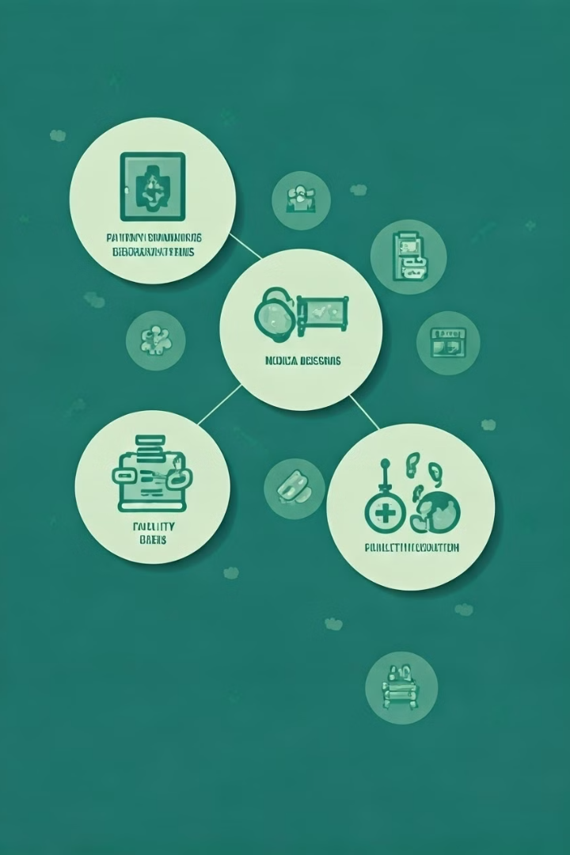
Database Design: Key Entities and Schema
Entity
Attributes
Patient
Patient ID, Name, Age, Address, Contact Information
Pregnancy
Pregnancy ID, Patient ID, Due Date, Delivery Date, Outcome
Facility
Facility ID, Name, Location, Type, Staff Information
Region
Region ID, Name, Population, Healthcare Infrastructure

Slide 4
Data Analysis Insights: Key Findings
Regional Variations
Facility Performance
Trends Over Time
Maternal mortality rates vary significantly across different regions, with some areas experiencing disproportionately higher rates.
Analysis reveals variations in facility performance, highlighting the need to address quality gaps and improve resource allocation.
Data analysis identifies trends in maternal mortality rates over time, providing insights into the effectiveness of interventions and areas for improvement.

Slide 5
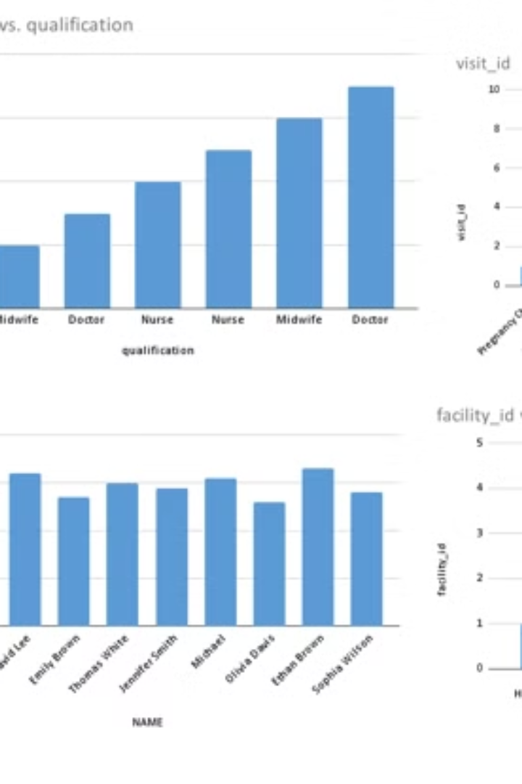



Excel Dashboard Demonstration: Interactive Visualization
Data Visualization
The dashboard uses interactive charts and graphs to present key data points and trends.
Filtering and Sorting
Users can filter and sort data by region, facility, and time period to analyze specific insights.
Drill-Down Capabilities
The dashboard allows users to drill down into specific data points for detailed analysis and investigation.

Slide 6

Impact and Future Considerations: Expanding the Project
Improved Healthcare
Empowered Communities
The project's insights can inform healthcare policy and resource allocation, leading to better healthcare services for mothers.
Data-driven awareness campaigns can educate communities on maternal health issues and promote preventive measures.
Future Expansion
The project can be expanded to include additional data sources, incorporate new technologies, and reach more rural communities.

Slide 7

Challenges and Lessons Learned: Overcoming Obstacles
1
Data Collection
Challenges in data collection, including incomplete records and data quality issues, were encountered.
2
Data Analysis
The project faced challenges in data analysis, such as data cleaning, outlier identification, and statistical modeling.
3
Communication and Collaboration
Effective communication and collaboration with stakeholders were crucial for successful project implementation.

Slide 8




Conclusion and Recommendations: Key Takeaways
Data-Driven Decisions
Community Engagement
Strengthening Healthcare Systems
Data analysis is crucial for understanding maternal health trends and informing effective interventions.
Engaging with communities is essential for understanding local needs and tailoring interventions accordingly.
Investing in healthcare infrastructure, training, and resource allocation is critical for improving maternal health outcomes.

